Slide 1
Uncertainty in Medicine
Harriet Hall, MD
The SkepDoc
Skeptics Toolbox 2013
Notes:
Ray asked me to talk about uncertainty in medicine, but I dunno.

Slide 3
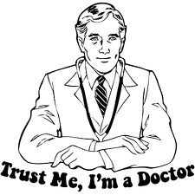
Notes:
I may be sorry for giving this talk. let you in on some of the “things your doctor doesn’t want you to know.” This is probably how you think of your doctor. And this is how you will probably think of him after my talk.

Slide 4
Shocking Fact: 50% of Doctors Graduated in the Bottom Half of Their Class
Notes:
I graduated back in 1970. Times have changed. I understand this is what they’re wearing at graduations these days. Seems appropriate

Slide 5
Notes:
While I’m on the subject of med school graduation, I’d like to share this with you.
I like to think I helped bring this about.

Slide 6
“The only certain thing about medicine is uncertainty.” -Marya Zilberberg

Slide 7
Medicine Is Riddled With Uncertainty
Medical histories are uncertain
Physical exams are uncertain
Tests are uncertain
Diagnosis is uncertain
Treatments are uncertain
Even human anatomy is uncertain
Doctors are not scientists. They are practical users of science who apply scientific evidence to patient care.
Medicine deals in probabilities and informed guesses, not certainties.

Slide 8
Medical Histories Are Uncertain

Slide 9
History
Chief complaint
History of present illness
Past medical history (surgeries, illnesses, medications, immunizations, allergies)
Family and social history
Review of systems
Notes:
A medical history consists of these components

Slide 10
Chief Complaint Is An Uncertain Guide
Reason patient states for seeing doctor.
There may be a more serious problem that is much more important than the one the patient is worried about
“Oh, by the way, Doc…”
Notes:
When the dr. asks what brought you in today, he doesn’t want to know if you took the bus. He wants to know what you’re concerned about
Then there’s the OBTW phenomenon. As the patient is leaving, he pauses with hand on doorknob and says “Oh by the way, doctor” and finally reveals what he is REALLY worried about.

Slide 11
What Do Symptoms Mean?
Sign of serious illness requiring treatment
Sign of illness we don’t yet know how to diagnose or treat.
Benign condition that will resolve
Hyper-awareness of body functions
Somatization and depression
Malingering
A cry for help

Slide 12
List of Problems
Notes:
My psychiatry professor in med school said a patient who brings in a long written laundry list of complaints is crazy until proven otherwise

Slide 13
Notes:
This book was on your reading list.

Slide 14
Challenger Memory Experiment
Right after the event, students wrote down how they had heard about it.
2 ½ years later they were asked the same question.
25% of answers were strikingly different.
Half were significantly different.
Fewer than 1 in 10 got the details right.
Almost all were certain that their memories were accurate.
One of them said, “That’s my handwriting, but that’s not what happened.”
Notes:
In it, he describes the Challenger memory experiment

Slide 15
Notes:
We all have those “senior moments” as we get older.

Slide 16
Relevance to History-Taking
Memory is unreliable
We forget
We distort
We conflate 2 memories into one
We remember things that didn’t happen
Patients report things that got their attention
Things they haven’t noticed may be more important

Slide 17
Medical History
Patients lie
Memory is fallible
They want to look good
They omit important info
How much pain on a scale of 1-10? Depends on mood, how question is understood, and whether the patient is stoic or a complainer.
Story changes with retelling
Notes:
Dr. House was right – everybody lies. Patients lie, deliberately or inadvertently. They may simply forget things, or they may deliberately hide things like drug abuse or extramarital sex
Try to present themselves in a favorable light. A patient told me she had “only one drink” a day. Turned out it was a huge tumbler filled to the brim with straight gin.
You should know that when you tell your doctor how much alcohol you drink, he assumes you are really drinking twice that much.
Important to mention: a patient called the ER because her baby was running a fever and she didn’t know how to read a mercury thermometer. In the course of the conversation, it turned out her baby had a shunt, a tube connecting the ventricles in her brain to her abdomen to remove excess fluid. A fever in a child with a shunt is a medical emergency, since infections can easily travel to the brain.
Pain reports vary by culture. A Puerto Rican may report a pain level of 11 on a scale of 1 to 10, while a Norwegian might say it doesn’t really hurt very much.
Last person to take a history gets the best history because the patient has had time to think about it, remember more details, and maybe change his mind about his answers
We can’t trust patients to tell us all we need to know.

Slide 18
Review of Systems
Notes:
The ROS asks about symptoms in various systems like the cardiovascular system and the gastrointestinal system. For GI it asks….
Answers depend on how significant the patient thinks the symptoms are. Heartburn? One patient will answer no because he thinks his occasional mild heartburn isn’t worth mentioning, another will answer yes because he had a mild sensation of burning for about 2 minutes one day last month.
Sometimes the ROS picks up significant problems, sometimes it produces a lot of unimportant, irrelevant information

Slide 19
Review of Systems
Notes:
Sometimes the patient answers yes to almost every question.

Slide 20
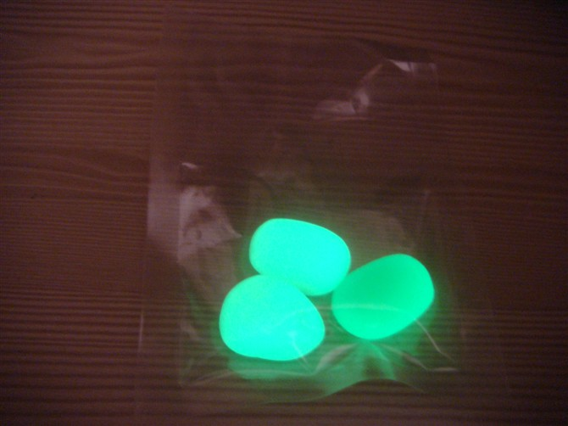
Test for Unreliable Historian
Do your teeth itch?
Do your stools glow in the dark?
Notes:
When that happens, we ask…. If they answer yes to these questions, we know we have a problem

Slide 21
Physical Exam Is Uncertain

Slide 22
Notes:
The physical exam findings are uncertain. The harder the doctor looks, the more likely he is to find things. If he is biased or has fixated on one diagnosis, he can miss signs of other diagnoses.
Here’s just one example: If the doctor just feels the abdomen without a diagnosis in mind, he’s likely to miss an enlarged spleen.
If he specifically checks for it, he puts his hands where you see in the picture and asks the patient to take a deep breath. As the patient inhales, the spleen will descend and he can feel it.
But if the spleen is REALLY enlarged, it might extend further down in the abdomen and this maneuver would miss it. If he’s highly suspicious, he will go on to check lower down.
You know how some doctors put the stethoscope in 2 places on the chest and listen briefly? That will miss a lot of abnormalities. A cardiologist looking for a specific heart problem will do a much more extensive exam.

Slide 23
Anatomy Is Uncertain

Slide 24
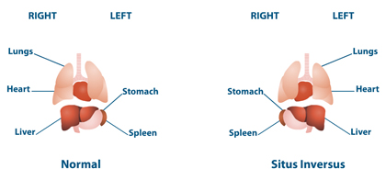
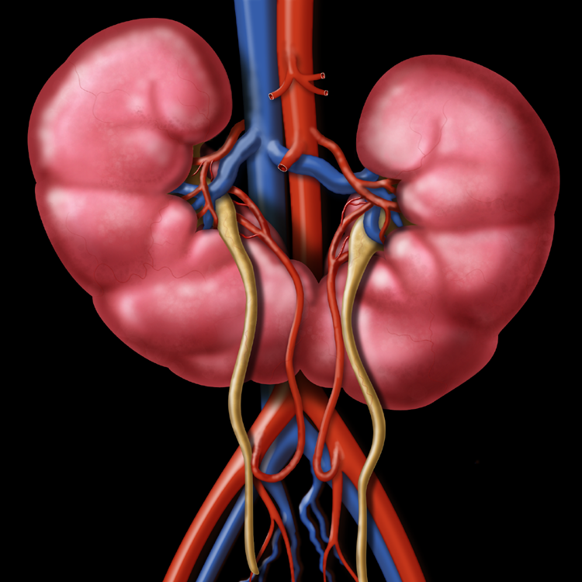
Situs inversus
Single kidney
Horseshoe kidney
Nerves and blood vessels are variable
Notes:
In situs inversus, the heart is on the right, the liver on the left, the appendix on the left. People with situs inversus are not eligible for military service, I guess because if they were wounded on the battlefield, they would confuse the trauma surgeon. Some people are born with a single kidney. Some have a horseshoe kidney where the two kidneys are fused together. Much of anatomy is variable: look at the veins on the back of your hands. Your two hands don’t even match.

Slide 25
It’s A Boy!
Don’t be so sure!
Sometimes what looks like a boy turns out
to be a girl, and vice versa.
Notes:
The sex of a newborn baby is obvious to the doctor. It seems very simple and straightforward.

Slide 26
Boys Look Different Under the Diaper
Notes:
The under-the-diaper test is usually accurate but Some babies are born with ambiguous genitalia, so it can be hard to tell

Slide 27
Determining Sex and Gender
More complicated than you probably realize
5 things determine biological sex in a newborn
the number and type of sex chromosomes
the type of gonads—ovaries or testicles
the sex hormones
the internal reproductive anatomy (such as the uterus in females)
the external genitalia.
Other factors act later in life to determine gender
Development of secondary sexual characteristics
Sex of rearing
Gender self-identification
Object of desire
Social gender
Legal gender
Notes:
I recently wrote an article about sex and gender for Skeptic magazine. In preparing that article, I learned a lot of things that I found fascinating, so I’m going to inflict some of them on you.

Slide 28
Chromosomal Sex Is Complicated
We have 46 chromosomes (23 pairs)
22 pairs of somatic chromosomes and one pair of sex chromosomes
Mitosis vs. meiosis
Notes:
In normal cell division, mitosis, cells are duplicated exactly, with all 23 pairs of chromosomes. In the ovaries and testes, instead of mitosis, the process is meiosis, where cells divided so that each gamete only contains 23, one of each pair of chromosomes. When an egg and a sperm unite at fertilization their single chromosomes unite to re-form pairs so the baby has the full 46.

Slide 29
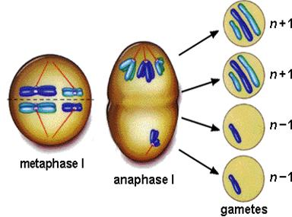
Accidents Happen: Dysjunctions and Crossovers
Notes:
On the left, two cells ended up with one chromosome too few, and two cells ended up with one too many.
Genetic material gets exchanged between the chromosomes of a pair by crossovers. Also deletions and additions: a piece of one chromosome is lost or gets stuck onto the other chromosome

Slide 30
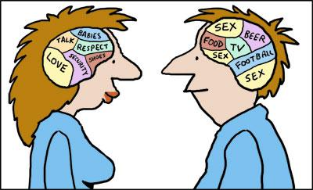
Chromosomal Sex
XX = normal female XY = normal male
Notes:
A normal female gets an X from each parent
A normal male gets an X from Mom and a Y from Dad.

Slide 31
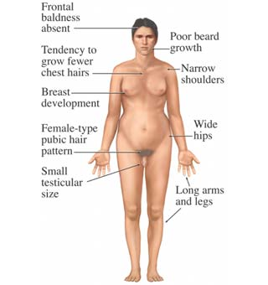
XO Turner’s Syndrome
XXY
Klinefelter’s Syndrome
Notes:
In Turner’s syndrome, the girl only gets one X chromosome.
In Klinefelter’s syndrome, a boy gets an extra X chromosome.

Slide 32
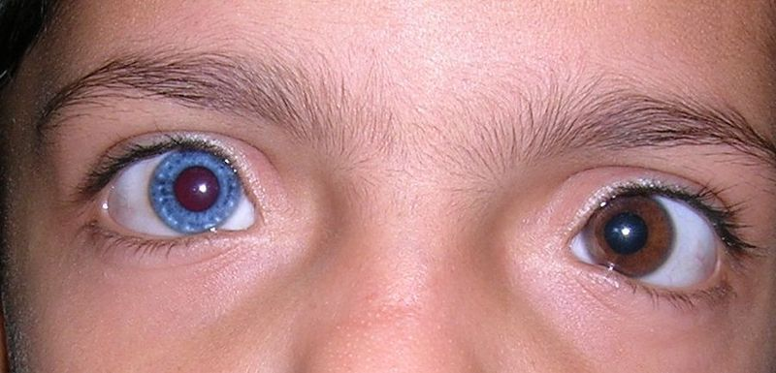
Others: XYY, XXX, XXXY, XXYY
Transposition: No Y; male sex determinants on X
Genetic mosaics:
Two people in one
One woman with a uterus had a mixture of 4 different cell lines: XX, XY, XO and XXY
Notes:
Mosaics: two genetically different cell lines in one individual
Gives new meaning to the words of Walt Whitman: I contain multitudes

Slide 33
Gonadal Sex
Testes (in scrotum or hidden in abdomen)
Ovaries
Both
Neither
Hermaphrodite ovotestis

Slide 34
Hormonal Sex
During fetal development
Excess adrenal hormones > female who looks like boy
Insensitivity to androgens > boy who looks like girl
5-ARD enzyme deficiency > boy is born looking like a girl but looks like a male after puberty
In adults
Underproduction of sex hormones
Overproduction of sex hormones
Pharmaceutical hormones
Notes:
CAH congenital adrenal hyperplasia
5-alpha reductase deficiency: androgen levels are normal but enzyme necessary for male genital development in the fetus is missing. The changes at puberty don’t require that enzyme

Slide 35
Internal Genitalia
Female: uterus, ovaries, vagina, Fallopian tubes
Male: epididymis, ductus deferens, seminal vesicles, ejaculatory ducts, prostate, bulbourethral glands
Any of these can be missing or abnormal
Up to 0.5% of women have a double uterus
Notes:
In one case, a woman had fetuses in each uterus, each with a different father of a different race (black and white), each delivered on a different date.

Slide 36
Appearance of External Genitalia
Normal or abnormal sized penis
Normal or abnormal sized clitoris
Ambiguous anatomy (small penis or large clitoris?)
Hypospadias (urethral opening on penile shaft)
Concealed penis
Aphallia: otherwise normal XY but no penis
Surgically constructed penis or vagina (sex change surgery)

Slide 37
Other Determinants of Sex/Gender
Development of secondary sexual characteristics (Breasts, pubic hair, facial hair, deep voice, enlarged penis and Adam’s apple) Natural or pharmaceutical-induced.
Sex of rearing (the David Reimer case)
Gender self-identification (gender dysphoria, feels as if assigned to the wrong sex)
Object of desire (male, female, both, neither, fetishes and paraphilias)
Social gender (clothing, behavior, role)
Legal gender
Notes:
John Money’s case, David Reimer. One of twin boys, circumcised at 8 months, penis accidentally destroyed. Money decided he would be better adjusted if he were raised as a female. The testes were removed, he was given female hormones and re-named Brenda. The sexual reassignment didn’t “take,” and as a teen switched to male hormones and re-assumed the name of David. He eventually married a women and later committed suicide.
Not a pure example of the sex of rearing, since he was initially reared as a boy
You’ve probably heard of shoe fetishes, but have you heard of
Plushophilia – sexual attraction to stuffed animals
Formicophilia – sexual gratification from being crawled on by insects
If you want to have some fun, look up lists of paraphilias on the Internet. There are some really amazing ones.
Cross-dressing, transgender
Legal: when does sex legally change in long sex-change process?

Slide 38
Sex and Gender Are Complicated
We are driven to categorize, but nature is endlessly inventive and is indifferent to our taxonomies.

Slide 39
He or She?
Notes:
Can you tell what sex this person is? I can’t.
I once heard a person speak at a conference and couldn’t decide which sex it was, so I used the bathroom test. I saw the person go into the women’s restroom.

Slide 40
Uncertainty in Lab Tests

Slide 41
Lab Tests: How Normal Is Defined
Notes:
Normal lab values are determined by doing the test on a large number of healthy people, generating a Bell curve, cutting off the 5% on the ends, and declaring the middle 95% normal.
So outside the normal laboratory range doesn’t necessarily mean abnormal

Slide 42
SMAC 20
Albumin.
Alkaline Phosphatase.
Alanine Aminotransferase (ALT).
Aspartate Aminotransferase (AST).
Bilirubin (total and direct).
Blood Glucose.
Blood Urea Nitrogen.
Calcium (Ca) in Blood.
Carbon Dioxide (Bicarbonate).
Chloride (Cl).
Cholesterol and Triglycerides Tests.
Creatinine and Creatinine Clearance.
Gamma-Glutamyl Transferase (GGT).
Lactate Dehydrogenase.
Phosphate in Blood.
Potassium (K) in Blood.
Sodium (Na) in Blood.
Total Serum Protein.
Uric Acid in Blood.
If you do 20 tests on normal person, one is likely to give a false positive result.
Notes:
When your doctor orders one of these tests, the lab is likely to do all 20 because they have a handy machine that does 20 tests for the price of one. And one of them is likely to give a false positive result just by chance.

Slide 43
Other Sources of Error
Physiologic variation (diurnal, pregnancy)
Margin of error
Human errors
Samples switched or mislabeled
Improper calibration
Procedural errors (wrong anticoagulant, tourniquet left on too long)
Clerical errors: misreading or miscopying
Interactions with drugs, supplements

Slide 44
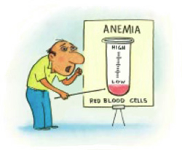
Misinterpreting Tests
Normal hemoglobin 14-18
Normal hemoglobin for males: 14-18
Normal hemoglobin for females: 12-16
Notes:
In med school we had to draw blood from each other, and our hemoglobin level was tested. They called two of us back and told us we were anemic. My classmate knew he was anemic: he had beta-thalassemia. My hemoglobin was 13, and I had to tell them I wasn’t anemic because the normal range for women was 12-16. They were so used to having male students that they hadn’t considered that fact. These were professors in medical school. You’d think they knew better.

Slide 45
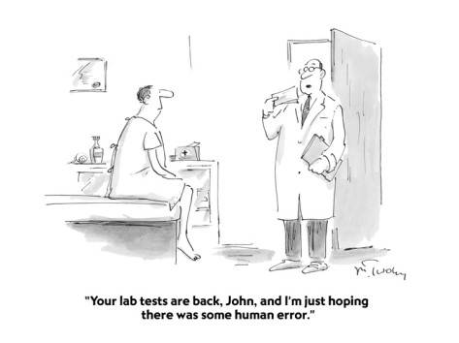
Never Believe One Lab Test
Notes:
Never believe one lab test. My mother was diagnosed with diabetes on the basis of one sky-high reading. We got a home glucose meter and checked her repeatedly and never got an abnormal reading. Had to go back and convince the doctor to remove the diabetes diagnosis from her medical record.

Slide 46
Even DNA Tests Can Be Misleading

Slide 47
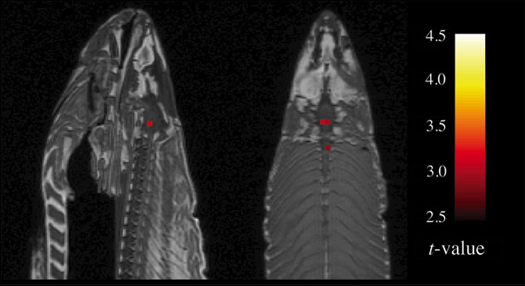
Brain Imaging Can Be Misleading
Just one problem: The salmon was dead.
The apparent brain activity was an artifact.
Notes:
This fMRI scan shows red areas in a salmon’s brain, indicating that those areas are active.

Slide 48
Notes:
This x-ray is a CT “slice” of a patient’s chest. I know you’re not radiologists, but take a look and see if anything jumps out at you. There is a gorilla in the red box. 83% of radiologist missed this when asked to read the x-rays looking for lung cancer
Good example of Inattentional blindness

Slide 49
Common Sense
Notes:
Tests have to be interpreted using common sense.

Slide 50
Cotard Delusion
Patient: “I’m dead.”
Doctor: Do dead men bleed?
Patient: No.
Doctor: Look, you’re bleeding!
Patient: By golly, dead men do bleed!
Notes:
Patients who have had a stroke or brain damage may develop Cotard Delusion. They believe they are dead, and no evidence can convince them otherwise

Slide 51
Uncertainty in Screening Tests
Notes:
Screening tests are uncertain, too.

Slide 53
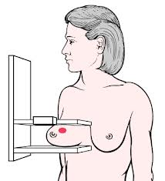
If Your Mammogram Is Abnormal, What’s the Likelihood You Actually Have Cancer?
100%
90%
70%
50%
30%
10%
Notes:
After mammogram, patient gets one of two postcards: your mammogram was normal, or please come back for further evaluation. If she gets the second postcard, what’s the likelihood that she actually has cancer? Which of these percentages do you think is the closest?

Slide 54
100%
90%
70%
50%
30%
10%
A positive screening test is not a diagnosis.
Notes:
The correct answer is 10%. If you guessed wrong, don’t feel bad. In a survey in Germany, most doctors got it wrong. They were most likely to guess something around 90%
Note: this is based on whole population. For women at high risk, the percentage would be greater.
The numbers aren’t important but the message is: a positive screening test is not a diagnosis.

Slide 55
Mammography Is Not As Good As Most People Think
If 1000 women are screened for 10 years starting at age 50:
2-10 women over-diagnosed and treated unnecessarily
5-15 diagnosed earlier with out any effect on final outcome
500 will have at least 1 false alarm
250 will undergo biopsy
1 life saved
999 would have lived just as long without a mammogram
IMPORTANT: THESE NUMBERS ARE FOR WOMEN AT AVERAGE RISK. MAMMOGRAPHY SAVES MORE LIVES WHEN WOMEN ARE AT HIGHER RISK

Slide 56
Prostate Cancer May Not Harm
Prostate cancer found in 80% of autopsies in men who die of other causes.
More men die WITH prostate cancer than BECAUSE of prostate cancer

Slide 57
Is PSA a Good Screening Test?
PSA is not a yes-or-no test (must consider age, rate of rise, other risk factors)
Any cutoff level is arbitrary
If PSA is positive, how many biopsies should be done?
Sampling 12 sites finds cancer in 25%
Repeat biopsy finds cancer in 25-30% more
Treatment is not benign
Notes:
If you could biopsy every cell in the prostate, you might find a cancer cell or two in almost everyone.
Treatment not benign. Option of watchful waiting if the cancer is small, localized, and not an aggressive type

Slide 58
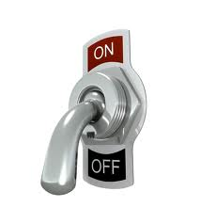
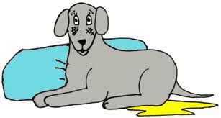
PSA Testing
Popular advice: “Get tested: it could save your life”
Expert advice: Don’t get tested. It does more harm than good.
Impotence Incontinence
Notes:
Harm: largely from side effects of treatment: impotence and incontinence are common.

Slide 59
What about the Routine Annual Physical?
Routine physical exams don’t reduce mortality.
Routine visits can still be worthwhile.
But the actual physical exam itself is largely a waste of time as a routine screening test.
Useful when symptoms present.
Notes:
The actual laying on of hands, listening to the lungs, looking in the ears, etc. is pretty much useless in patients with no symptoms. It rarely finds anything that would make a difference in the patient’s final health outcomes.

Slide 60
Uncertainty in Genetic testing
SNPs give probabilities based on imperfect information
People with your SNP have a 30% higher than average risk of Parkinson’s disease
Average risk even for the highest risk group is 1 in 14 (7%); 30% higher = 9 %
Genetics is not destiny
Gene expression depends on environmental factors, epigenetic factors, interaction with other genes
Our access to genetic information currently exceeds our understanding of what that information actually means.
Notes:
SNP = single nucleotide polymorphism
Just because you have the gene for a disease doesn’t mean you will develop that disease. It depends on whether the gene is expressed.

Slide 61
Uncertainty in Diagnosis

Slide 62
Making a Diagnosis
70% history
20% physical
10% tests
Notes:
The diagnostic process is uncertain. Tests are not the most important factor. 70% of dx made on history alone, 20% more from PE, last 10% from tests

Slide 63
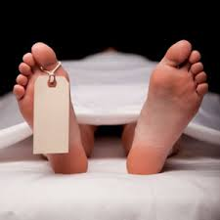
Making a Diagnosis
Notes:
Sometimes we can’t arrive at a diagnosis until autopsy. That’s why they say pathologists are best diagnosticians, but only after it’s too late.

Slide 64
Final Certainty
Alzheimer’s – no certainty until autopsy
Pregnancy – certainty in 9 months
But not always. Lithopedion.
Sometimes even autopsy is uncertain.
Notes:
Alzheimer’s can’t be definitively diagnosed until autopsy.
Lithopedion – instead of being born, baby remains in abdomen and calcifies. Sometimes these calcified fetuses are surgically removed as long as 40 years after the pregnancy.
Sometimes even autopsy doesn’t find a definite cause.

Slide 65
Blood Test for Rheumatoid Arthritis
RF – rheumatoid factor
Positive in 70-80% but may be delayed
False positives in infections, autoimmune diseases, and cancer
Notes:
There’s a blood test for RA, and you might think diagnosis would be a simple matter of doing the test. But it’s only positive in 70-80% of RA patients and it may not appear until late in the course of the disease. Lots of other things can give false positive results.

Slide 66
Is It Rheumatoid Arthritis?
Morning stiffness in and around the joints for at least one hour.
Swelling or fluid around three or more joints simultaneously.
At least one swollen area in the wrist, hand, or finger joints.
Arthritis involving the same joint on both sides of the body (symmetric arthritis).
Rheumatoid nodules, which are firm lumps in the skin of people with rheumatoid arthritis. These nodules are usually in pressure points of the body, most commonly the elbows.
Abnormal amounts of rheumatoid factor in the blood.
X-ray changes in the hands and wrists typical of rheumatoid arthritis, with destruction of bone around the involved joints. However, these changes are typical of later-stage disease.
Rheumatoid arthritis is officially diagnosed if four or more of these seven factors are present. The first four factors must have been present for at least six weeks.
Notes:
RA is diagnosed if 4 or more of these are present and have been present for long enough.

Slide 67
Must Rule Out
Gout and pseudogout
Osteoarthritis
Lupus
Lyme disease
Reactive arthritis
Anklyosing spondylitis
Hepatitis C
Rarer causes like sarcoidosis, amyloidosis, Whipple’s disease, hemochromatosis, rheumatic fever, gonococcal arthritis
Notes:
And before a diagnosis of RA is made, all of these must be ruled out.

Slide 68
Sensitivity, Specificity, and Predictive Values
A test is positive in 87% of those who have Alzheimer’s.
The test is negative in 85% of those who don’t have it.
But these numbers don’t mean anything by themselves.
What if a population of 10,000 has a 5% prevalence?
 | Number | Positive Test | Negative Test
Have Alzheimer’s | 500 | 87% of 500 = 435 | 65
Don’t have it | 9500 | 1425 | 85% of 9500 = 8075
Total number | 10,000 | 1860 | 8140
If you test positive, what’s the likelihood that you actually have the disease? PPV= 24%.
If you test negative, what’s the likelihood that you really don’t have the disease? NPV=99%
Positive test
 | Number | Positive test | Negative test
Have Alzheimer’s | 500 | 87% of 500 = 435 | 65
Don’t have it | 9500 | 1425 | 85% of 9500 = 8075
Notes:
It’s important to understand S, S, and PV.
A press release announced a new test for Alzheimer’s that was Positive in 87% = sensitivity
Negative in 85% = specificity
You have to know the prevalence of the condition in the population being studied
Positive predictive value 24%
Negative predictive value 99%
So this test would be good at ruling OUT Alzheimer’s, but it wouldn’t be good at ruling it IN.
Screening tests are much more accurate for diseases with high prevalence

Slide 69
Tests Don’t Make a Diagnosis
Tests don’t make a diagnosis; they only raise or lower the likelihood of the diagnosis compared to the pre-test likelihood.
In the Alzheimer’s example:
Pre-test probability = 5% (prevalence)
Post-test probability = 24% if test is positive and 1% if test is negative

Slide 70
ER Patient With Swollen Tender Knee – Is It A Joint Infection?
Pretest probability 18%
Fluid aspirated from knee joint:
WBC 55,000? Raises probability to 63%
WBC 25,000? Lowers probability to 7%
Post-test dilemma:
Treat now? 37% chance of giving unnecessary antibiotics
Consider it ruled out? 7% chance of not giving necessary treatment.
Notes:
Here’s an example of a doctor’s thinking process using pre and post test probabilities.
It’s important to determine whether it is infection (septic arthritis) versus something like trauma or arthritis.
Septic arthritis requires IV antibiotics. If not treated, permanently damage the joint.
Of all patients coming into an ER with those symptoms, 18% turn out to have an infection.
Testing the fluid for white blood cells can raise the likelihood to 63% or lower it to 7%

Slide 71
DSM = Uncertainty Squared
Diagnostic and Statistical Manual of Mental Disorders
Axis 1 | Axis 2 | Axis 3 | Axis 4 | Axis 5
Clinical disorders | Personality/development disorders | Relevant physical disorders | Psychosocial Environmental problems | Global Assessment of Functioning
Schizophrenia Eating disorders Anxiety disorder | Borderline personality disorder, Narcissistic personality disorder | Congenital abnormalities Diseases of nervous system and sense organs | Educational problems Problems with primary support group Housing problems | 100 = superior functioning 10 = persistent danger of hurting self or others
Notes:
Psychiatry is the most uncertain field of medicine, and the DSM makes it even more uncertain. DSM uses these 5 axes. I’ve included examples of each.

Slide 72
Example of Example of DSM Diagnosis DSM
Axis | Diagnosis | Code
I | Major depressive disorder, single episode, severe, without psychotic features Alcohol abuse | 296.23 305.00
II | Dependent personality disorder, frequent use of denial | 301.6
III | None
IV | Threat of job loss
V | GAF = 35 (current)
Notes:
Here’s a typical DSM diagnosis with appropriate codes.

Slide 73
Criticisms of DSM
Reliability and validity of diagnoses is questionable
Categorizes by symptom, not cause
Arbitrary distinctions and cut-offs
Cultural bias (it used to list homosexuality as a psychiatric disorder)
Medicalization
Stigma of label
Financial conflict of interest
Notes:
DSM has been widely criticized.

Slide 74
Is there a gold standard placebo-controlled RCT?
Often no studies or inadequate studies
Sometimes the best information we have is wrong
50% of all published studies are wrong
Doctors have to act on inadequate information
Notes:
RCT= randomized controlled trial

Slide 75
Treatment Is Uncertain

Slide 76
Doctors Can’t Afford Analysis Paralysis
If they hesitate like Hamlet, their patients may die
Notes:
Analysis paralysis coined by Marya Zilberberg?

Slide 77
Surgeons Must Decide and Act
Notes:
…efore the patient bleeds to death
They must have a lot of self- confidence to do what they do…

Slide 78
Uncertainty in Surgery
Notes:
But not too much confidence

Slide 79
Balancing Humility and Confidence
“The practice of medicine requires a careful mix of humility and confidence. Finding this balance is very tricky, as humility can become halting indecision and confidence can become reckless arrogance.” - Peter Lipson

Slide 80
The Wisdom of Will Rogers
“It isn’t what we don’t know that gives us trouble, it’s what we know that ain’t so.”
Bloodletting
Routine episiotomies
Radical mastectomy
Notes:
For centuries doctors believed bloodletting saved lives. In reality, they were killing patients.
For decades we routinely did episiotomies when we delivered babies. We thought it reduced pressure on the baby’s head and we thought a controlled cut was easier to repair than an uncontrolled laceration. Neither was true. We aren’t doing them routinely any more.
We thought radical mastectomies would prevent metastases. They don’t. Because cancer cells have already spread to other parts of the body. Now we do simple mastectomies or lumpectomies

Slide 81
Picking a Drug
Choosing the right drug for the right patient is mostly a crap shoot
Genetic testing promises to eventually guide us in individualizing drug choices, but it isn’t of much practical use yet.

Slide 82
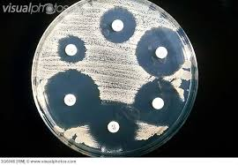
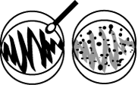
Which Antibiotic To Choose?
Waiting for culture and sensitivity reports is not an option: patient may die before results come back.
We must guess and treat empirically while waiting for results.
Consider exposure, travel, immune status, allergies, which bacteria most commonly cause the disease in patient’s age group, drug-resistant strains in the community.
Then GUESS
Notes:
A sample from the infected area is swabbed on a culture plate and incubated. Bacteria grow all over the plate. The white discs are impregnated with different antibiotics. The one that kills off the largest area of bacteria is the one that will work best for the patient.

Slide 83
Uncertainty In Communication
Patients don’t remember most of what a doctor tells them
Patients getting palliative chemotherapy for terminal cancer thought it offered a chance of cure or longer survival when it was only intended to ease their dying
Non-adherence

Slide 84
It’s OK To Say “I don’t know.”
Notes:
Better to tell patient you don’t know than to make something up

Slide 85
Sometimes We Don’t Need a Diagnosis

Slide 86
When To Stop Pursuing a Diagnosis
Reasonable certainty that serious diseases have been ruled out
Likelihood of further tests finding something significant and treatable is diminishingly small.
Further tests are only likely to harm the patient through false positives, false hopes, wild goose chases, unnecessary anxiety, invasive and dangerous tests
Notes:
At some point doctors need to stop testing and accept uncertainty. You can do that when…

Slide 87
Doctor Can Tell Patient:
I don’t know what’s wrong with you but I know a whole lot of things that aren’t wrong with you
I’ve ruled out all the things that are likely to kill you or do serious harm
We could do more tests, but I wouldn’t know how to decide which tests to do, and would have to just order them at random. I suppose we could do every test in the book in the hopes of finding something, but we’d get false positives and it’s very unlikely we would find anything significant.
At this point, more tests are likely to do more harm than good (for instance, we could do surgery to open up your abdomen and look around, but you wouldn’t want that)

Slide 88
Alternative To More Testing
Let’s stop worrying about “why” you have these symptoms and focus on “how” to cope with them and improve your quality of life.
Three things could happen:
Symptoms could go away (if so, who cares what caused them)
Stay the same; keep trying different ways of coping
Get worse, or new symptoms develop > reevaluate and reconsider need for further tests
Notes:
I used to tell my patients that, and they were usually relieved and willing to accept that plan.

Slide 89
Uncertainty Is OK
“I think it's much more interesting to live not knowing than to have answers which might be wrong. I have approximate answers and possible beliefs and different degrees of uncertainty about different things, but I am not absolutely sure of anything and there are many things I don't know anything about, such as whether it means anything to ask why we're here. I don't have to know an answer. I don't feel frightened not knowing things, by being lost in a mysterious universe without any purpose, which is the way it really is as far as I can tell.” - Richard Feynman

Slide 90
What Doctors Do
Make an educated guess based on the best available evidence and on their estimates of probability
Make decisions without having enough information to be certain they are right
Act on those decisions.
Notes:
Evidence: half of published studies wrong

Slide 91
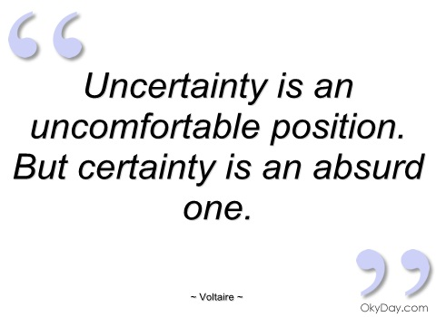
Uncertain, But Still Best Option
Medicine deals in uncertainties, probabilities and informed guesses based on science.
CAM deals in certainties based on fantasy and intuition.
Notes:
Science-based medicine is full of uncertainty, but it’s still by far the best option.

Slide 92
Certainty Trumps Evidence in CAM
“Integrative medicine” guru Andrew Weil set up tests of osteopathic manipulation for ear infections, and when the experiments showed no effect, he said, “I’m sure there’s an effect there. We couldn’t capture it in the way we set up the experiment.”
Notes:
He values his own (unreliable) experience over scientific evidence. That’s essentially a pre-scientific attitude. Shame on Weil!

Slide 93
Alternative Medicine Offers Certainty
It’s subluxations! (Chiropractic)
It’s parasites! (Hulda Clark)
It’s toxins! (Sherry Rogers)
It’s acidosis! (Robert Young)
It’s an imbalance of qi! (acupuncture)
Notes:
The chiropractor is certain your symptoms are due to subluxations that can be fixed with chiropractic adjustments
Hulda Clark was certain all disease was due to parasites and could be cured with her zapper device, but she couldn’t cure herself. She died of cancer and didn’t even try using her own zapper.
Sherry Rogers is sure your problems are due to toxins
Robert Young is sure they are due to acidosis
The acupuncturist is certain your problem is due to obstructions or imbalances in the flow of qi, and is certain that sticking needles in acupoints will somehow fix the problem

Slide 94
The One True Cause(s) of All Disease
Toxemia Subluxations Oxygen deficiency Psora “Fearful, tight and negative minds” Obstruction of ch’i along the meridians Refined sugar “Fault of awareness” Grains in the diet False beliefs and fears “Imbalance” Ama due to aggravated doshas Stress Anger A “non-perceivable but very real attachment to the material aspect of creation”
Modern medicine Some morbid agent, producing irritation
and inflammation
A weak “immine” system Malnutrition Free radicals An imbalance of electrons in the cellular atoms atoms Emotion Sin Food abuse Allergies Ignorance of reality Dis-ease on any level (physical, emotional, mental, soul or spiritual) is
incorrect vibratory rate(s), patterns which are
not appropriate, or blocked energy pathway(s)
within or between the various levels of existence The blood Morbid humors Poisonous chemicals Emotional trauma “Allurement” of the mind by sense objects and
its “willfulness” in gratifying these desires
Notes:
I once searched the web for “The One True Cause of All Disease” and found 67 of them
But wait! There’s more!

Slide 95
More One True Cause(s) of All Disease
Inadequate nutrition A congested colon “All disease is a learned experience which we can un-learn.” “All illness is in our minds,” and we can cure it with faith in God, meditation, or whatever. Spiritual vital force and its dynamic derangement Holding on to energy within the physical, emotional and spiritual bodies that is not in harmony with us Impairment of movement of the bones of the skull Bad health habits Nerves too tense or too slack God Lack of life Witchcraft Miasms
Blocked nerves Our inability to adapt Overeating Poverty Toxic metals
Food acidity
Cold
Arrogance Violation of natural law
And my favorite: “the United KKK States of America is the root cause of all disease…”
Notes:
KKK: I have no idea what that means, but I guess it feels good to have someone to blame

Slide 96
Medicine Recognizes Many Causes of Disease in 9 Categories
V – Vascular
I – Infectious/inflammatory
N – Neoplastic
D – Drugs/toxins
I – Intervention/iatrogenic (caused by our treatments)
C – Congenital/developmental
A – Autoimmune
T – Trauma
E – Endocrine/metabolic
And sometimes there’s more than one cause (e.g., a traumatic injury gets infected).
Notes:
We use the mnemonic VINDICATE:

Slide 97
Where science finds complexity, alternative medicine imagines simplicity.
As H.L. Mencken said, “For every complex problem, there is an answer that is clear, simple—and wrong.”

Slide 98
Cranks and Quacks
Lack humility in the face of disease.
Have confidence without knowledge.
Promise the improbable (to stop aging, to cure autism)
Most important, they don’t know what they don’t know, and that makes them dangerous.

Slide 99
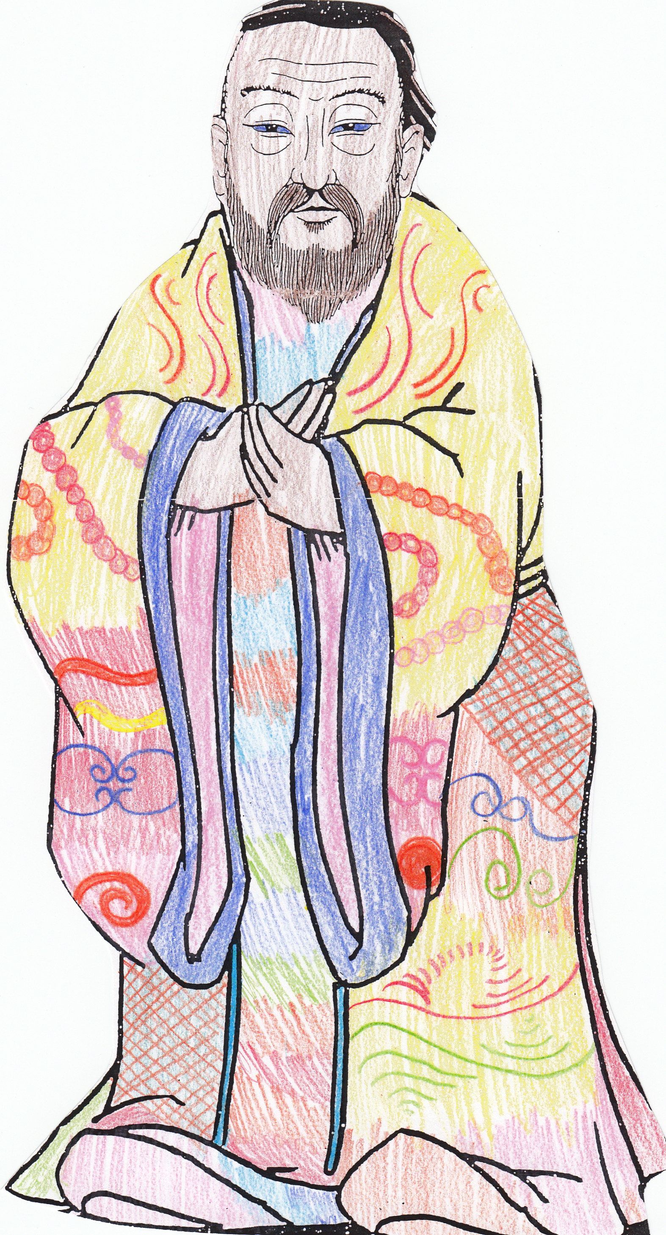
Confucius Say:
“Real knowledge is to know the extent of one’s ignorance.”

Slide 100
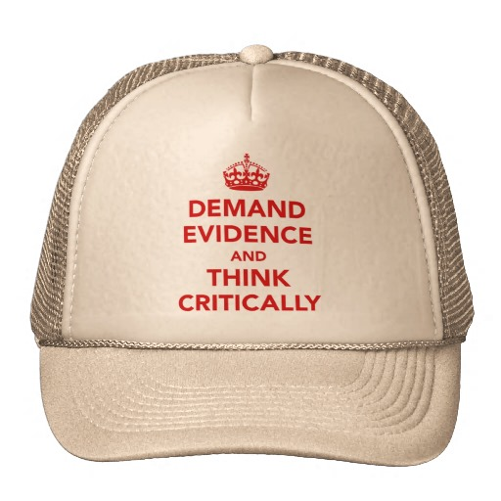
Which Hat Is Your Healthcare Provider Wearing?

Slide 101
How Science Works
“It would be nice if we could all agree that science is not static, but rather progresses and regresses. We learn, and then find out that some of what we thought we had learned was wrong, and set about using that information to seek the next level of truth. Repeat, ad infinitum. Personally, I’d love it if my doctors couched every bit of advice with, ‘Here’s what we think we know today.’” - Sherry Boschert
Notes:
In her book Plug In Hybrids

Slide 102
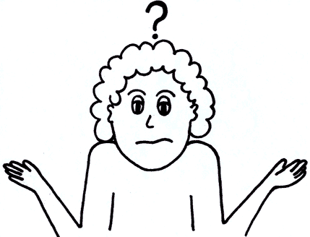
IBTHOOM
My favorite diagnosis.
Notes:
It Beats The Hell Out Of Me!

Slide 103
“The only certain thing about medicine is uncertainty.” -Marya Zilberberg
Notes:
I think I’ve convinced you by now that the only certain thing about medicine is uncertainty.
That’s discouraging, so…

Slide 104
Braco the Gazer
Notes:
I’d like to leave you with a healing moment.
Pronounced brahtzo
Croatian who stands on a podium and silently stares at the audience for 5-10 minutes
He doesn’t make any claims for himself, but his supporters say that during the gaze time they can feel tingling, see energy or a golden aura, experiince peace or relief from pain. And they claim to have been miraculously cured of everything from migraine to heart disease to cancer.
He is making millions by just standing there doing nothing. Wouldn’t you like to have a job like that?
His supporters claim that just looking at his picture is sufficient for healing, so …

Slide 105
Notes:
Here’s a closeup
Behold! And Be Healed

